Slide 1
Welcome to API - Workshop
@Sage Pay
14th September 2018

Slide 2
Before we start
Wifi :
Password:
Checklist
Atom Text Editor If you don't already have a text editor (Sublime is also fine).
Chrome browser if you don’t have it already.
Postman
JSON View Chrome plugin.

Slide 3
Before we start
Go to https://github.com/foundersandcoders/workshop-api
And follow the instructions to download

Slide 4
Icebreaker
Name Game
Your name
Your Spirit Animal
What made you decide to come to this workshop

Slide 5
What is an API?

Slide 6
WHAT IS AN API?
Application Programming Interface
Glue of the digital landscape
Enables interaction between devices
Connection between services & servers, internal or external
Describes a way to plugin to a service, e.g. to use 3rd party software and build tools for your website
https://www.youtube.com/watch?v=s7wmiS2mSXY
Notes:
https://www.theguardian.com/media/pda/2007/dec/14/thenutshellabeginnersguide

Slide 7
For Example
http://fcscripters.github.io/moodNews/
Notes:
Many types of APIs
Libraries & Frameworks
System communication
Websites

Slide 8
Web Architecture

Slide 9









Client - Server Architecture
www.unicornbook.com
Request
Response
Resource
Notes:
Animation showing step by step:
Client (we) make a request to the server
Server checks database or forwards requests to other server
Server sends response with requested resource
Resource = hypermedia documents (HTML & CSS files)

Slide 10
Client - Server Architecture
3-Tier Architecture
Request
Response
Client Layer
Business Layer
Data Layer
Presentation tier
Logic tier
Data tier

Slide 11
Where APIs fit in...
A
P
I
A
P
I
Request
Response
Web applications
Web Services
Data source

Slide 12
HTTP

Slide 13
HTTP - HyperText Transfer Protocol
HyperText Transfer Protocol
Web protocol used every time your computer make a request to get a resources from a server
Underlying protocol of the Web by Tim Berners-Lee (1989)
Notes:
client sends a request for some resource (e.g. 'Get me the index.html file') and the server sends back a response (e.g. 'Here's the file').

Slide 14

HTTP in the Client-Server Architecture
HTTP
www.unicornbook.com
Request
Response
Notes:
HTTP = protocol for transmitting resources (= hypermedia documents, such as HTML, CSS etc)
Handles the communication between web browser of client and web server
Stateless protocol => meaning after the data transfer between request & response has been completed, server does not save any data, i.e. doesn’t know about previously made requests
Important because it makes request and response cycle quicker and independent. Also means, each request needs to contain enough information to be served
The server could track those if it wanted, i.e. program like web service handling it
But statelessness simplifies the “contract” and amount of data sent per request
What do we do if we want to save the state, i.e. a certain person logging in?
Using HTTP Cookies
Sessions
Hidden variables
Encoded parameters in the URL
https://www.quora.com/Why-is-HTTP-protocol-called-stateless-protocol

Slide 15
HTTP - HyperText Transfer Protocol
Every HTTP Request from client contains
Request Method - Tells server which type of action the client wants
URI - Unique Resource Identifier = Address of the required resource
Header fields - Optional, for extra information, e.g. authentication
Body - Provides information sent by the client server
Notes:
Header & Body are also referred to as Request Object

Slide 16
HTTP Methods in Request
GET
POST
PUT
DELETE
Notes:
DELETE

Slide 17
HTTP Request Methods
Method | Description
GET | Retrieves information from the given server using a given URI. Requests using GET should only retrieve data and should have no other effect on the data
POST | Sends data to the server, for example customer information, file upload, etc. using HTML forms
PUT | Similar to POST in that sends data to the server but replaces existing content at the specified URI, or creates a new resource if none exists (idempotent)
DELETE | Removes the resource at the target URI
Notes:
GET
Uses query parameters to identify the resource wanted (no manipulation)
POST
sending data in request object to a specific resource
PUT
Idempotent = the same request produces the same result.
E.g. a resources at unicornbook/blueunicorn1 gets updated with the same data every time that PUT request is made
Main difference:
In POST, the resource will know how to handle the data in the POST request
E.g. might upload a new picture (data-accepting)
or function as gateway e.g. authenticate
or forward the request + data to a separate entity/ program
In PUT, only that one resource indicated in the URL is changed.

Slide 18


HTTP Status codes in Response
www.unicornbook/pink.com
Request
404
Response

Slide 19
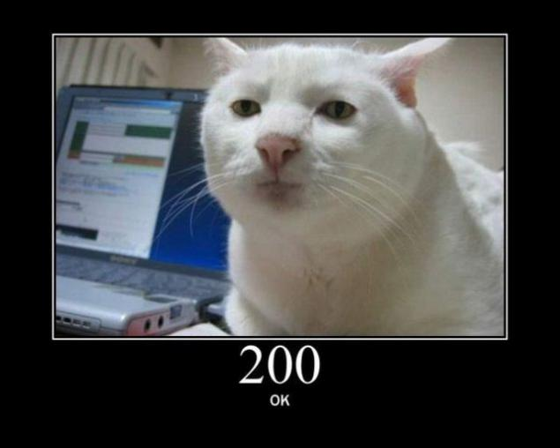
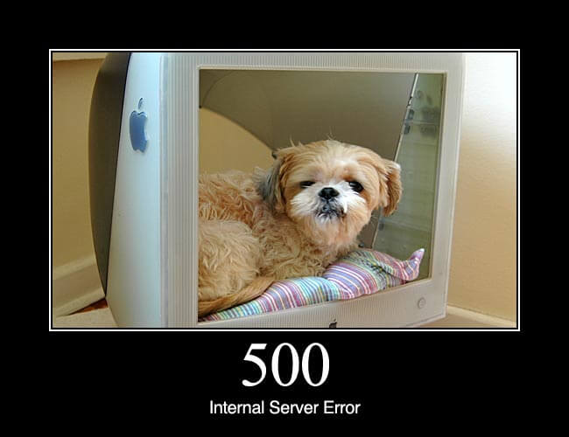
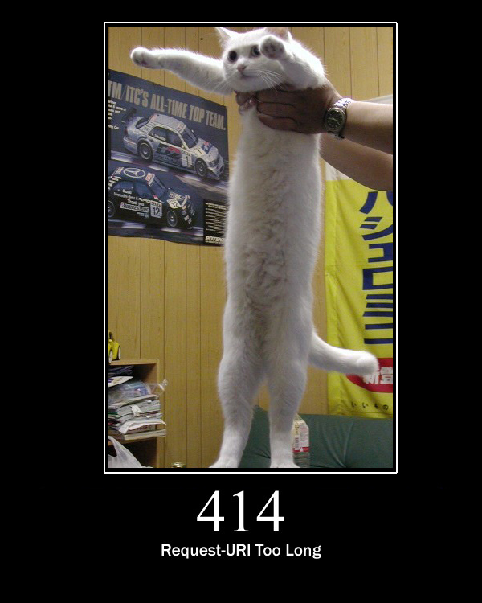

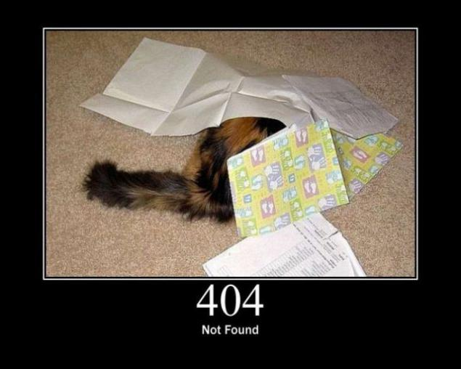
Notes:
Example in Postman

Slide 20
HTTP Status codes in Response
1xx - Informational
2xx - Success
3xx - Redirection
4xx - Client Error
5xx - Server Error
https://httpstatuses.com/
https://http.cat/
Notes:
HTTP Responses always include:
Status Code (machine readable)
Reason Phrase (human readable)
Are grouped in the following

Slide 21
404
https://bebo.com/OpenMedia.jsp

Slide 22
Postman Challenge
Postman
From zip folder. morning challenge.md
https://anapioficeandfire.com

Slide 23
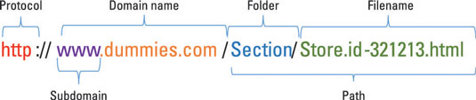
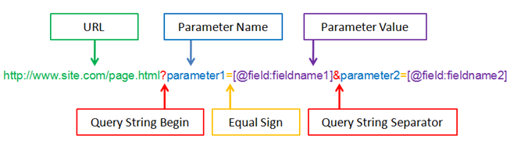
LET’s TAKE a LOOK aT A URL & Query strings
Notes:
URL = Endpoint

Slide 24
Difference URI, URN & URL
Unique Resource Identifier
Identifies a resource uniquely
Further classified as
Unique Resource Name
Globally unique name to identify the resource
Unique Resource Locator
In addition to identifying the resource provide how to access it (address)
URI
URN
URL
http://
Unicornbook
/blueunicorn.hmtl
/blueunicorn-pic.png
Notes:
URN & URL are types of URI
=> all URLs are URIs but not all URIs are URLs
https://danielmiessler.com/study/url-uri/

Slide 25
Web Applications
Vs
Web Services

Slide 26
Client - Server Architecture
www.unicornbook.com
Request
Response
Notes:
Remember the basics…
Client + Browser
Server + Database
Client side usually has the Web Application as a program to handle requests
Server side consists of many web services, programs that process request by calling other programs or databases

Slide 27

Web Application VS WEB Service
Web Application
User-to-program interaction (user interface)
Runs in browser on client side
Handles client request on which server provides response
Web Service
Program-to-program interaction
Runs on the server side
Provides the data requested by the program of the client
Notes:
The web is no longer just a collection of static text documents with a few images and GIFs thrown into the mix.
Over the last twenty years or so, we’ve seen the web coalesce into a slurry of web apps small and large, each one more complex and dynamic than the last,
strung together with APIs, scripts, and more data than anyone could have ever imagined

Slide 28
API Design = Web Service Design
Collection of open protocols & standards used to exchange data between applications & systems
There needs to be a medium & format
Medium = HTTP
Format → 2 Types:
SOAP (older)
RESTful (newer)
Notes:
Format = architectural style or design approach taken to handle requests

Slide 29
API Backend design
SOAP vs RESTful

Slide 30
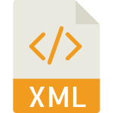
SOAP
Simple Object Access Protocol
Messaging protocol to exchange data amongst services in the web
Uses XML format

Slide 31

RESTful
Representational State Transfer
Another messaging protocol mostly using JSON format
Uses HTTP verbs
Used by 70% of web services
Notes:
https://www.restapitutorial.com/index.html
Many other protocols using different formats

Slide 32
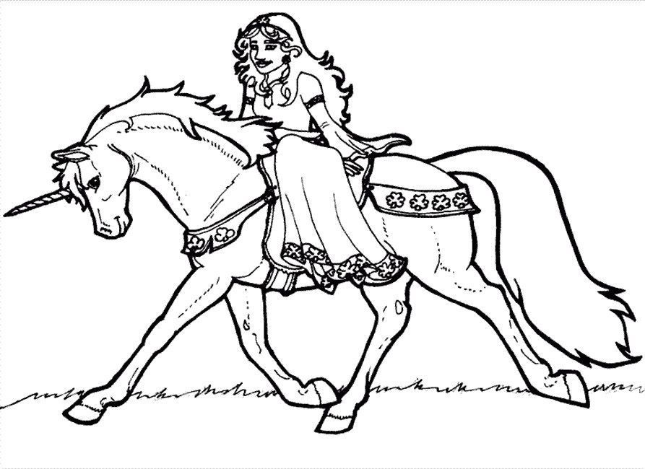

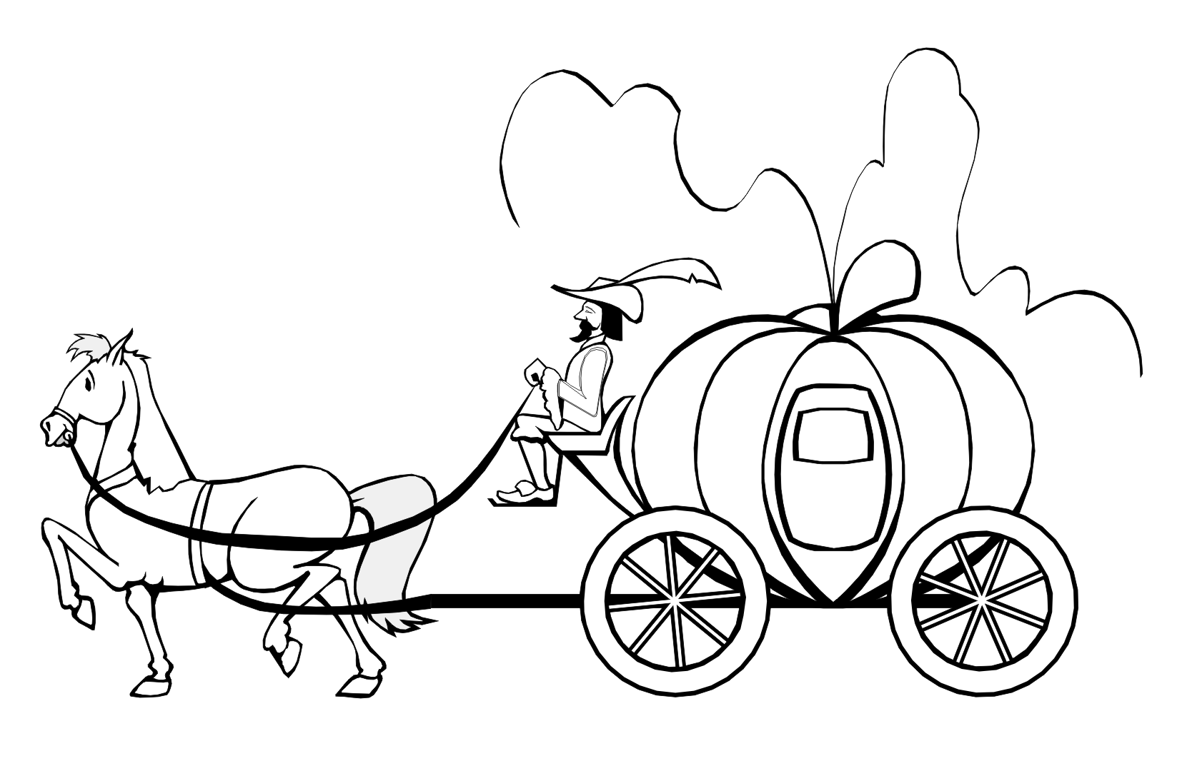
SOAP vs RESTful & HTTP
REST
HTTP
SOAP
Notes:
REST: “rides on HTTP directly”, plain & simple request objects*, requires contract between services as REST simply accesses data
SOAP: wraps the data like a coach, comfort of contract but increased complexity (performs operation on data)
Choice depends on philosophy/ experience/ compatibility
Many other protocols using different formats
*POJO with primitive data types > converted by JSON library > Using HTTP Verbs in annotation to handle request
@Post
methodDoesX(POJO p){
service.doX(p);
}

Slide 33
Data Formats
JSON, XML ….

Slide 34
JSON
JavaScript Object Notation
Early 2000 by Douglas Crockford
https://www.json.org/
“A lightweight data-interchange format. Easy for humans to read and write. Easy for machines to parse and generate”
“A way to store information in an organized, easy-to-access manner”
Notes:
human-readable collection of data that we can access in a really logical manner

Slide 35
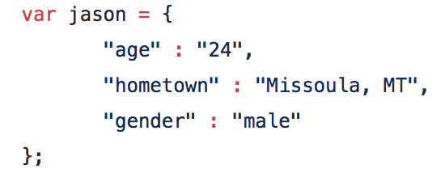
JSON example
Key-value pair object
Accessible via jason variable

Slide 36
JSON example
https://jsonplaceholder.typicode.com/
https://anapioficeandfire.com/

Slide 37
XML
Extensible Markup Language (1996)
Another format used to receive data from a web server
Hierarchically defined structure
Mostly used with SOAP Design
Notes:
https://www.w3schools.com/js/js_json_xml.asp

Slide 38
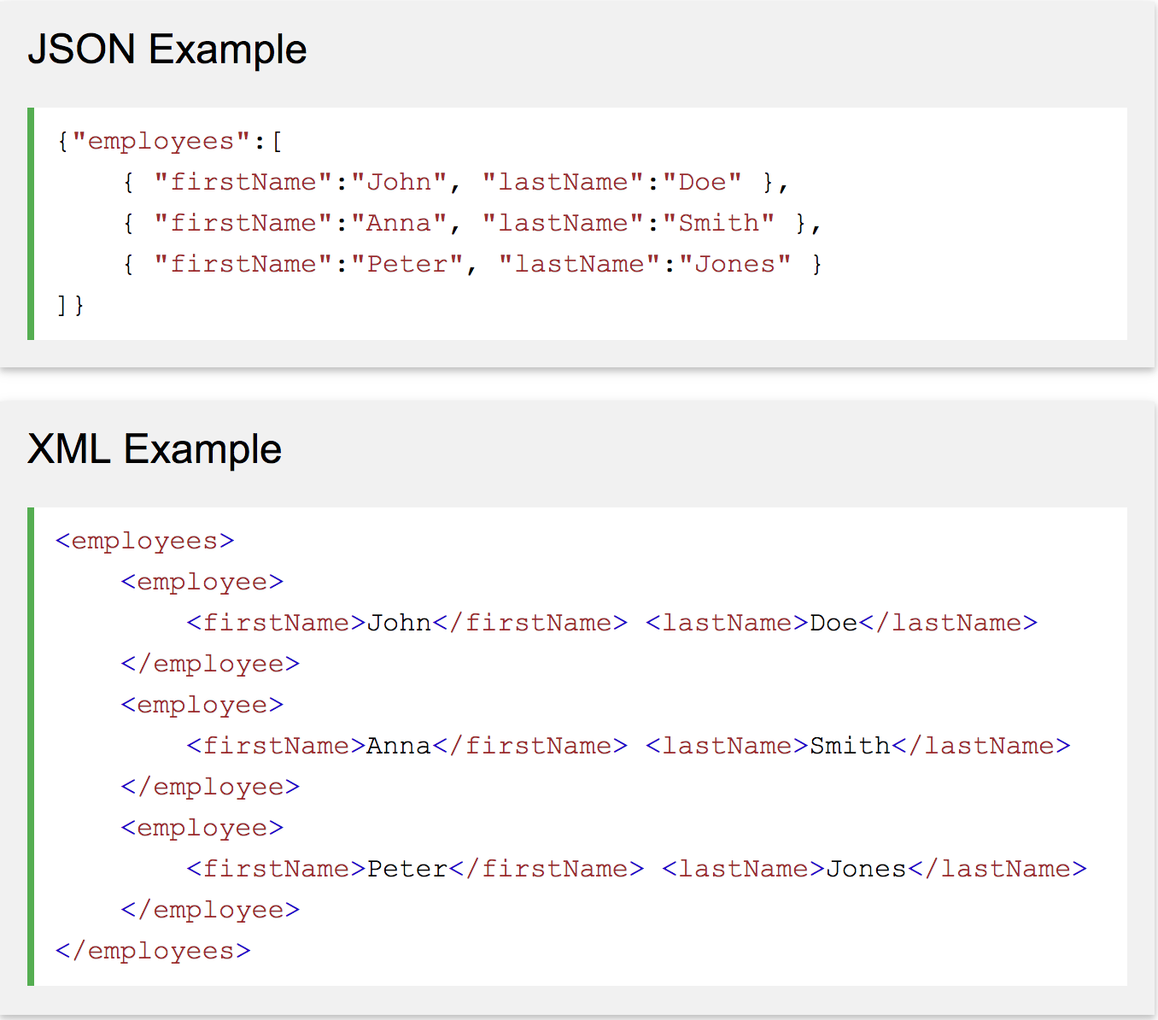
JSON VS XML
Notes:
Similarities: self-describing (human-readable), hierarchical
Differences: XML has to be parsed with an XML parser, JSON is parsed in a ready-to-use JS object

Slide 39
API Security
Keys

Slide 40
What is API Security
Most API require the client to be authenticated before allowing them access to the data
Why?
track & control use of API
Avoid abuse & a way of filtering access
How?
Provided you have an API Key you will be granted access to the data
Username and Password
Most API’s are now protected by OAuth 2 = Two-factor Authentication
Notes:
Q. we are working with FE, where would you put the key if you want to keep it secure?

Slide 41


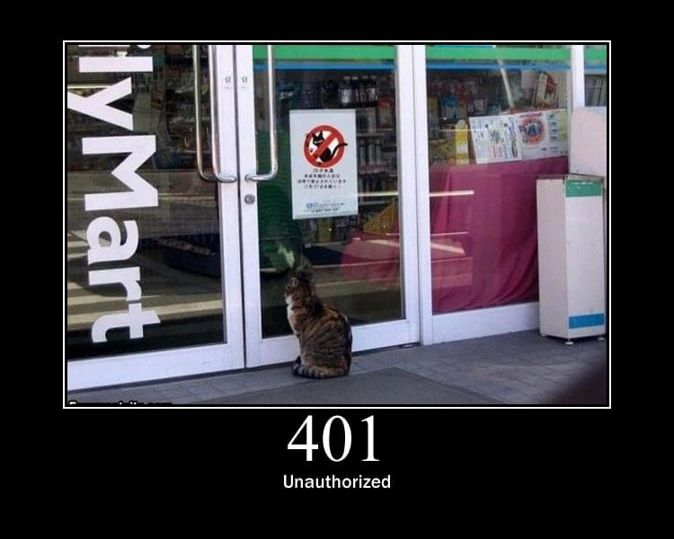

API Keys
Like Username & Password
Provided after registration, has to be sent with every request in HEADER
Unique, created by a cryptographic algorithm
Request
Notes:
Cryptographic = encrypted text (ciphertext)
Everytime request is sent, it has to include the key
That key is checked by service for validity

Slide 42

A word of Warning
Backend provides ability to hide the API key
Frontends sometimes don’t
We need to hide the key, else we risk theft & misuse
Never let your keys hang around in a script!
Github tools:
git-remote-gcrypt
git-secret
git-crypt
Notes:
if someone else gets a hold of our key and uses it too excessively, we may be banned from using the API or charged a lot of money
For us to be able to use Auth protected API’s we need to have a backend
Hence for the workshop we are only using open APIs, which do not require a key to access data.
Github tools = add functionality to encrypt your Github repository
https://medium.freecodecamp.org/how-to-securely-store-api-keys-4ff3ea19ebda

Slide 43
API Documentation
Why it is so important

Slide 44
API Documentation Tools
Tells you how to use an application’s interface
E.g. OpenAPI/Swagger Specification
Write your documentation in Markdown files (similar to HTML docs)
Follow the specification, i.e. set of rules to define your endpoints, paths, parameter, methods etc
Rendered via the Swagger engine to look nice
https://petstore.swagger.io/
Notes:
Tells you how to use a service, ie. how to integrate with the interface
= Manual
Good documentation should be seen as a major deliverable when building a service

Slide 45
API Resources
What is an API? Video
API 101. Link
https://anapioficeandfire.com
GET and POST: Link

Slide 46

Challenges!

Slide 47
Feedback
https://marisa56.typeform.com/to/Yj2mCx

Slide 48
Sources
https://github.com/foundersandcoders/workshop-api
https://anapioficeandfire.com/
SOAP Web Services 01 - Introduction To Web Services
https://blog.aujas.com/2015/02/24/understanding-and-testing-web-services-part-1/
https://stackify.com/soap-vs-rest/
https://www.quora.com/What-is-the-difference-between-web-service-and-web-application
https://openweathermap.org/api
https://www.restapitutorial.com/index.html
https://www.copterlabs.com/json-what-it-is-how-it-works-how-to-use-it/
https://en.wikipedia.org/wiki/XML
https://www.json.org/
https://www.w3schools.com/js/js_json_xml.asp
https://nordicapis.com/why-api-keys-are-not-enough/
https://blog.logrocket.com/the-easiest-way-to-keep-your-web-apps-accessible-c2b57506cc2a

Slide 49
Fetching API Data using Javacript.

Slide 50
https://anapioficeandfire.com
create simple. html file, add javascript xhr request and then add jquery.getJSON using one of the request from above.

